Slide 1
Sustainable & Maintainable Code

Slide 2
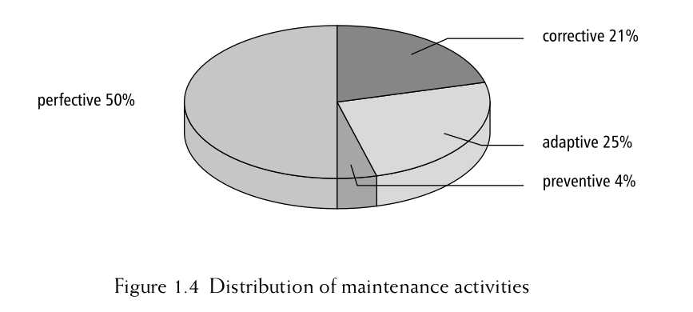
What is code maintenance?
Hans van Vliet. (2007) Software Engineering: Principles and Practice. Wiley. pp16.
Notes:
software life cycle
New requirements
New features
Adapt to changing tech
Fix performance
– corrective maintenance -- the repair of actual errors;
– adaptive maintenance -- adapting the software to changes in the environment,
such as new hardware or the next release of an operating or database system;
– perfective maintenance -- adapting the software to new or changed user
requirements, such as extra functions to be provided by the system. Perfective
maintenance also includes work to increase the system’s performance or to
enhance its user interface;
– preventive maintenance -- increasing the system’s future maintainability.
Updating documentation, adding comments, or improving the modular struc-
ture of a system are examples of preventive maintenance activities.

Slide 3
❝ Software models part of reality,
and reality changes,
whether we like it or not.
So the
software has to change too. ❞
Hans van Vliet. (2007) Software Engineering: Principles and Practice. Wiley. pp16.

Slide 4
/*
* Dear Maintainer
*
* Once you are done trying to ‘optimize’ this routine,
* and you have realized what a terrible mistake that was,
* please increment the following counter as a warning
* to the next guy.
*
* total_hours_wasted_here = 73
*
* undeclared variable, error on line 0
*
*/

Slide 5
//When I wrote this, only God and I understood what I was doing
//Now, God only knows

Slide 6
// drunk, fix later

Slide 7
// Magic. Do not touch.

Slide 8
// I am not sure if we need this, but too scared to delete.

Slide 9
//Peter wrote this, nobody knows what it does, don't change it!

Slide 11
Python 3.6.9 (default, Mar 15 2022, 13:55:28)
[GCC 8.4.0] on linux
Type "help", "copyright", "credits" or "license" for more information.
>>> print "hello world"
File "<stdin>", line 1
print "hello world"
^
SyntaxError: Missing parentheses in call to 'print'. Did you mean print("hello world")?
Notes:
Print moved from statement to function

Slide 12
The Levels of Software Reusability
We want to ensure our software is reusable by others, as well as ourselves
What do we mean by ‘reusable’?

Slide 13
Reproducibility
Good science is reproducible.
Data + Code → results
Same Data + Same Code → Same results
← Reproducible
New Data + Same Code → Same results
← Replicable

Slide 14
1.
2.
3.
4.
5.
Re-runnable
Repeatable
Reproducible
Reusable
Replicable
Benureau, Fabien CY, and Nicolas P. Rougier. "Re-run, repeat, reproduce, reuse, replicate: transforming code into scientific contributions." Frontiers in neuroinformatics 11 (2018): 69.

Slide 15
Levels of reuse
Re-runnable: the code is simply executable and can be run again (but there are no guarantees beyond that)
Repeatable: the software will produce the same result more than once
Reproducible: published research results generated from the same version of the software can be generated again from the same input data
Notes:
to be and remain re-runnable on the computers of other researchers, a re-runnable code should describe—with enough details to be recreated—an execution environment in which it is executable.
The code is running and producing the expected results. The next step is to make sure that you can produce the same output over successive runs of your program.
A result is said to be reproducible if another researcher can take the original code and input data, execute it, and re-obtain the same result

Slide 16
Levels of reuse
4. Reusable: easy to use, understand, and modify
5. Replicable: the software can act as an available reference for any ambiguity in the algorithmic descriptions made in the published article. That is, a new implementation can be created from the descriptions in the article that provide the same results as the original implementation, and that the original - or reference - implementation, can be used to clarify any ambiguity in those descriptions for the purposes of reimplementation
Benureau, Fabien CY, and Nicolas P. Rougier. "Re-run, repeat, reproduce, reuse, replicate: transforming code into scientific contributions." Frontiers in neuroinformatics 11 (2018): 69.
Notes:
Later levels imply the earlier ones. So what should we aim for? As researchers who develop software - or developers who write research software - we should be aiming for at least the fourth one: reusability. Reproducibility is required if we are to successfully claim that what we are doing when we write software fits within acceptable scientific practice, but it is also crucial that we can write software that can be understood by others. If others are unable to verify that a piece of software follows published algorithms and ideally modified. Where ‘others’, of course, can include a future version of ourselves.

Slide 17
Approaches to sustainability
Technical preservation (techno-centric):
Emulation (data-centric)
Migration (functionality-centric)
Cultivation (process-centric)
Hibernation (knowledge-centric)
Deprecation
https://www.software.ac.uk/resources/approaches-software-sustainability
Notes:
The easiest way to ensure that there will always be hardware on which to run your software, is to preserve the hardware
You want to keep your software, but you’re worried that technical preservation might leave you with no hardware or an expensive maintenance bill. The alternative may be emulation. An emulator is a software package that mimics your old hardware (and, possibly, your operating environment) so that it can be run on any computer.
If you need to reliably reproduce the operation of your software, the best choice may be migration. With this approach, you re-code your software so that it will work on new hardware or operate with new and reliable software. Re-coding for migration also gives you the perfect opportunity to enhance your software’s operation by fixing bugs or adding new features.
Cultivation is the process of opening development of your software. This is where you allow developers access to your code – under a licence – so that they can work with you. The deal is that outside developers get access to your code so that they can adapt your software to meet their exact needs, but any bugs they fix or new functionality they add is given back to your project.
Rather than sustaining your software in an operational state, you could choose to hibernate it. Hibernation could be the right approach to follow when your software has come to the end of its useful life, but there is the possibility that the software might need to be resurrected to double-check analysis or prove a result. Alternatively, there may not be a user community for your software, but you believe one will occur in the future. Hibernation allows you to preserve the knowledge about your software so that it can be easily resurrected in the future.
Take it out to the car park and

Slide 18
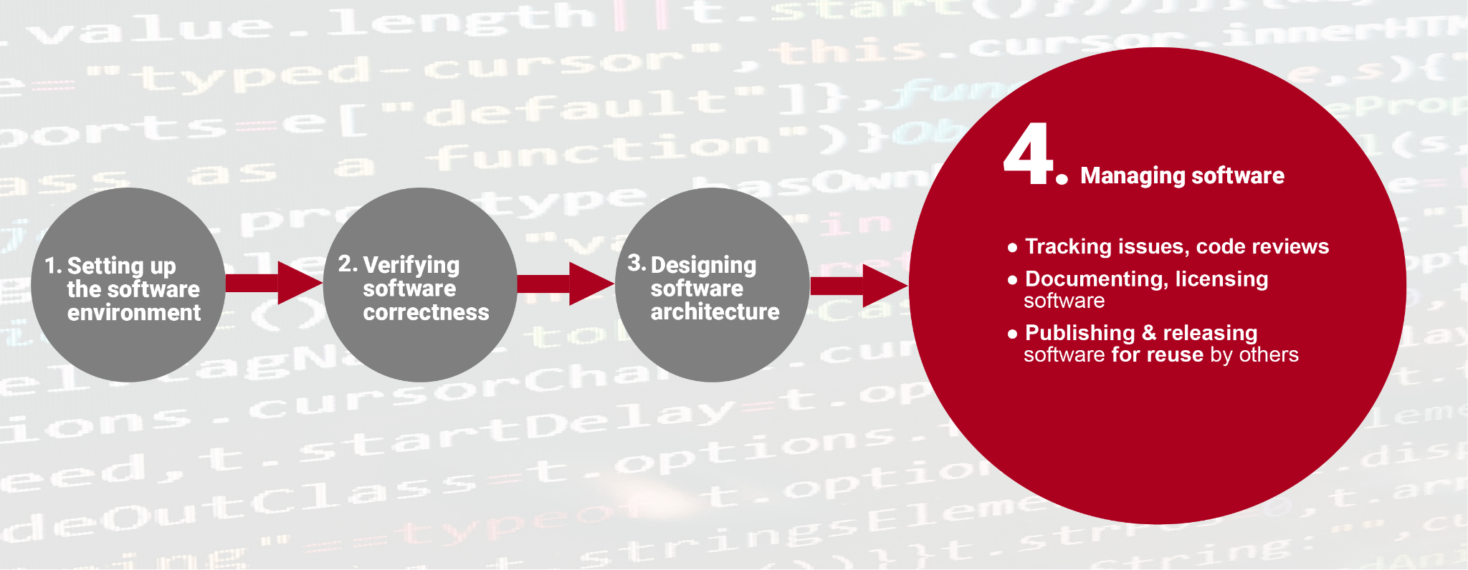

Slide 19
Maintainable software == writing good software
Design for maintainability from the outset
Iterative development and regular reviews help to improve quality
Readable code is easy to understand ("write programs for people")
Refactor code to improve its understandability
Relevant documentation helps developers understand the software
Automated build make the code easy to compile
Automated tests make it easy to validate changes
Continuous integration makes the code easier to build and test
Version control helps keep code, tests and documentation up to date and synchronised
Change the way you work to make maintainability a key goal
https://software.ac.uk/resources/guides/developing-maintainable-software

Slide 20
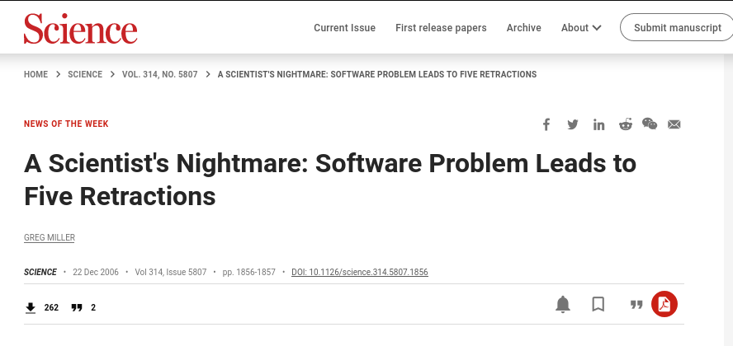
Prevention is better (and cheaper) than cure

Slide 21
Toolchest
http://www.cio.com/article/706050/Using_Pair_Programming_Practices_in_Code_Inspections
http://codebetter.com/blogs/jeremy.miller/archive/2006/08/13/148258.aspx
http://www.basilv.com/psd/blog/2006/how-to-create-maintainable-software
http://www.basilv.com/psd/blog/2006/the-importance-of-maintainable-software
Evaluate your own software: https://www.software.ac.uk/resources/online-sustainability-evaluation

